Slide 1
Nervous System
An Introduction

Slide 2
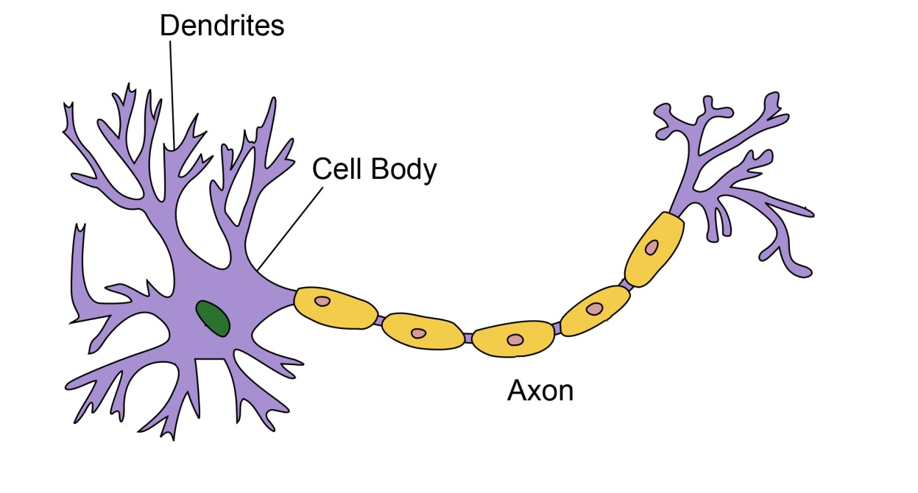
The Nervous System: Communication
Neurons are masses of nerve cells that transmit information
Three main components:
(1) Cell Body – contains the nucleus and two extensions
(2) Dendrites – shorter, more numerous, receive information
(3) Axon – single long “fiber” which conducts impulse away from the cell body, sends information

Slide 3
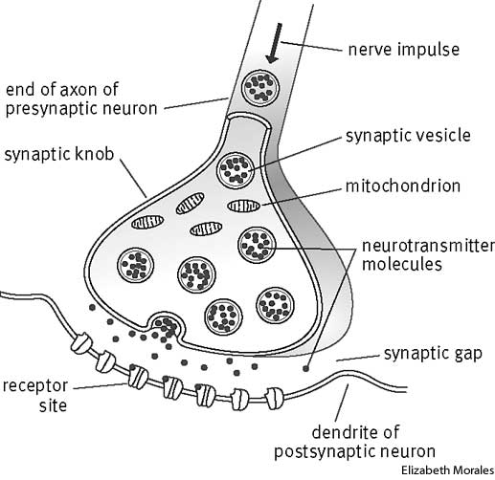
The Nervous System: The Synapse
Each synaptic terminal is part of a synapse, a specialized site where the neuron communicates with another cell.
Two cells meet at every synapse:
1) presynaptic cell – sends the message
2) postsynaptic cell – receives the message

Slide 4
The Nervous System: The Synapse
Communication between cells at the synapse occurs by releasing chemicals called neurotransmitters. Neurotransmitters are packaged in vesicles, and are released by the presynaptic cell (neuron) and received by the postsynaptic cell (neuron, muscle, gland).

Slide 5
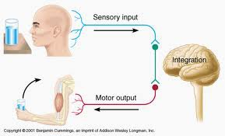
Three Basic Functions of the Nervous System
(1) Sensory – gathers information
(2) Integrative – information is brought together
(3) Motor – responds to signals to maintain homeostasis

Slide 6
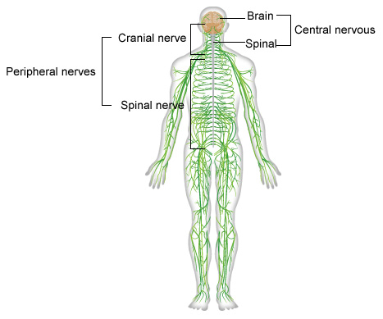
Division of the Nervous System
There are two divisions of the nervous system:
(1) Central Nervous System (CNS) – includes brain and spinal cord
(2) Peripheral Nervous System (PNS) – includes nerves of the body
Includes 31 pairs of spinal nerves
12 pairs of cranial nerves

Slide 7
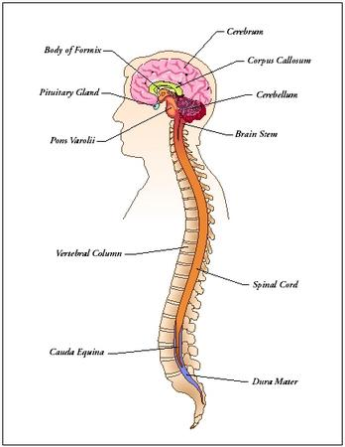
Central Nervous System (CNS)
Responsible for integrating, processing, and coordinating sensory data and motor commands
Sensory data convey information about conditions outside or inside your body.
Motor commands control or adjust the activities of peripheral organs, like the skeletal muscles.

Slide 8
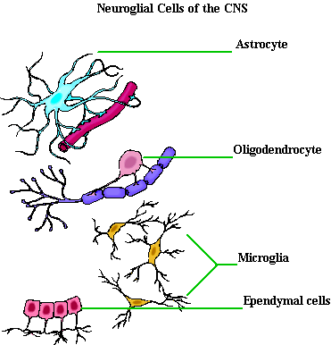
CNS Neuroglial Cells
Function as support cells for the neurons
Four main types of neuroglial cells found in the CNS:
(1) Microglial cells
(2) Oligodendrocytes
(3) Astrocytes
(4) Ependymal Cells

Slide 9
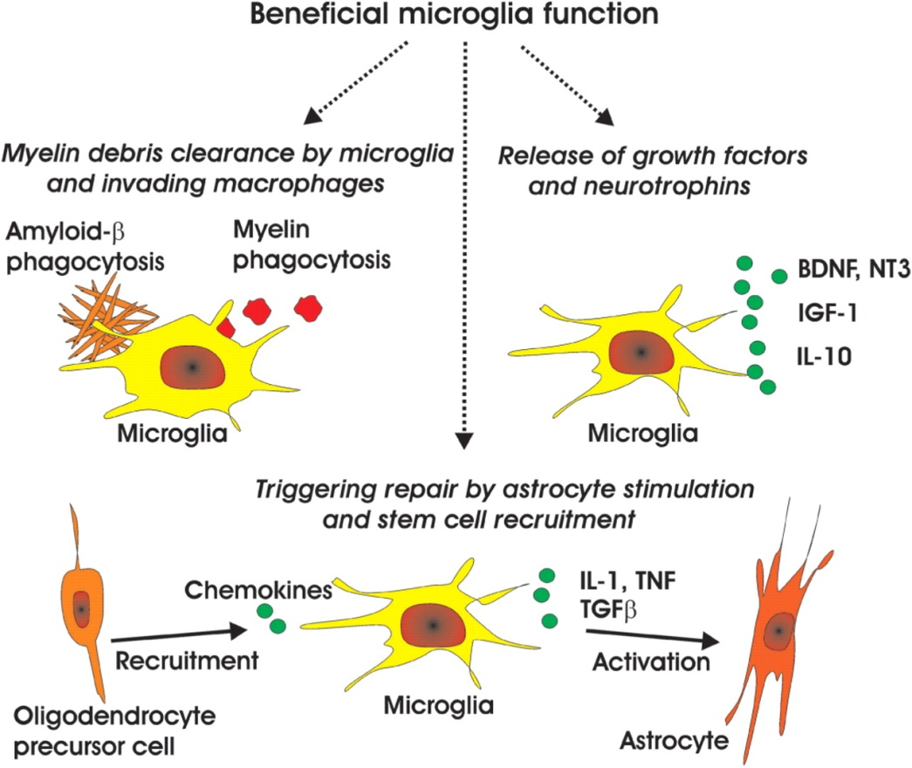
Microglial Cells
Found scattered throughout the nervous system. Least numerous and smallest neuroglia in the CNS. Function to digest debris or bacteria
*Microglial cells respond
to immunological alarms!

Slide 10
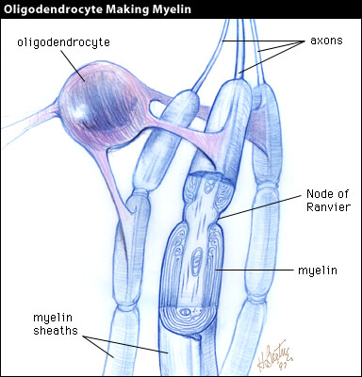
Oligodendrocytes
Wraps around the axon, forming concentric layers of cell membrane
called myelin. This wrapping increases the speed at which the action potential travels along the axon.

Slide 11
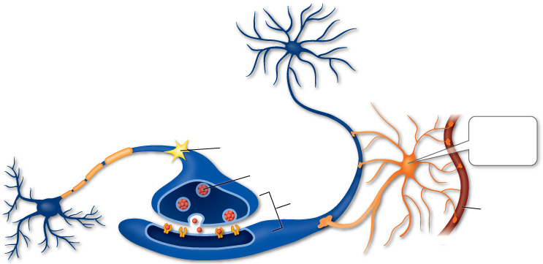
Astrocytes
Astrocytes connect blood vessels to the neurons. They are the largest and most numerous neuroglia in the CNS.
*They are responsible for:
Maintaining the blood-brain barrier
Repairing damaged neural tissue
Guide neuron development
I connect to blood vessels!

Slide 12
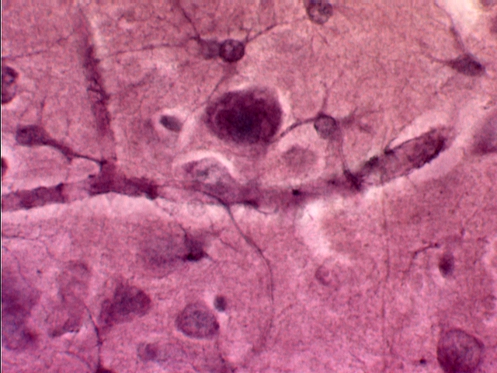
Astrocyte
Astrocytes
Neuron
Astrocyte contacting blood vessel and neuron
Blood vessel

Slide 13
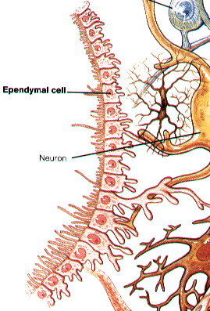
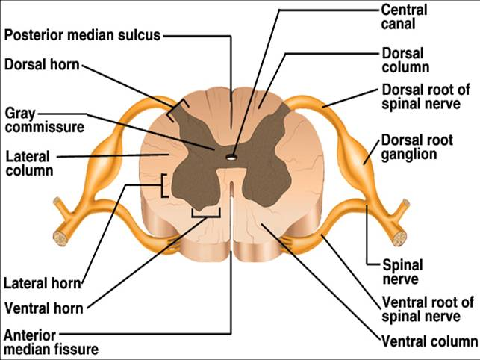
Ependymal Cells
Ependymal cells form a membrane that lines the ventricles (chambers) of the brain and the central canal of the spinal cord.
Assist in producing, circulating, and monitoring of cerebrospinal fluid

Slide 14
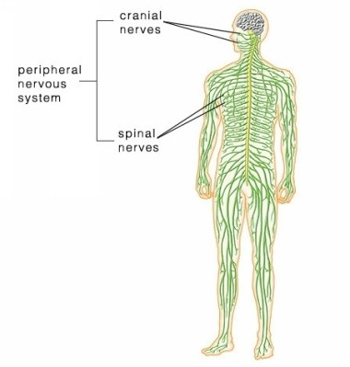
Peripheral Nervous System
Includes all of the neural tissue outside the CNS
Delivers sensory information to the CNS and carries motor commands to peripheral tissues and systems

Slide 15
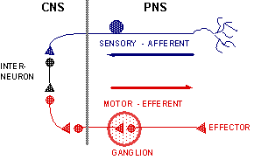
Functional Division of the PNS
Two divisions of the PNS:
(1) Afferent division – brings sensory information to the CNS from receptors in peripheral tissues and organs
(2) Efferent division – carries motor commands from the CNS to the muscles and glands. Those target organs, that respond by doing something, are called effectors.

Slide 16
Division of the Peripheral Nervous System
Within the efferent peripheral nervous system, there are two more systems responsible for motor functions:
(1) Somatic Nervous System – controls skeletal muscle contractions (voluntary) and involuntary skeletal contractions like those seen in reflexes (automatic response – put hand on hot stove, remove it quickly)
(2) Autonomic Nervous System – provides automatic regulation of smooth muscles, cardiac muscle, and glands (involuntary)

Slide 17
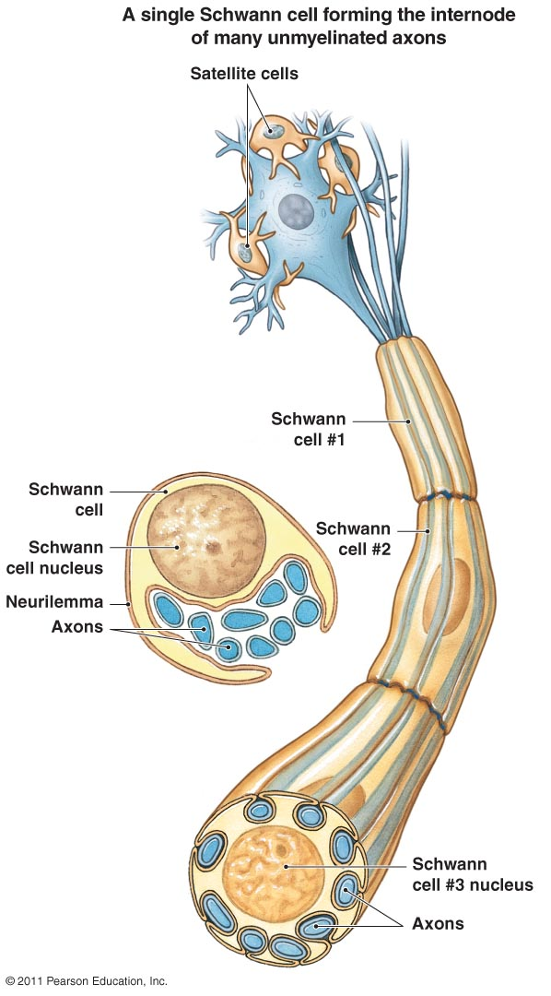
Neuroglia of the Peripheral Nervous System
Two main types of neuroglia involved:
(1) Satellite cells (amphicytes) – regulate the environment around the neurons, similar to astrocyte’s job
(2) Schwann cells – myelinates only one segment of a single axon. Also engulfs damaged and dying nerve cells.

Slide 18
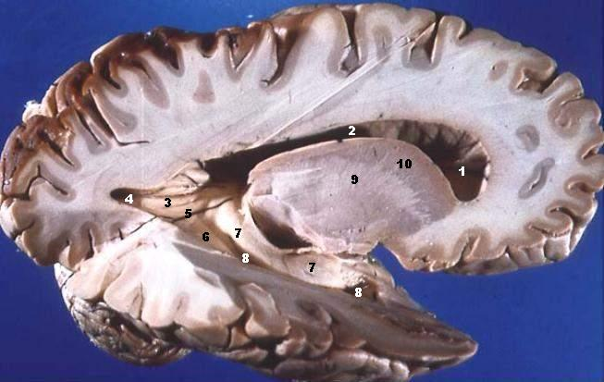
White VS Gray Matter
Myelinated (white matter) – myeinated axons
Unmyelinated (gray matter) – unmyelinated axons

Slide 19
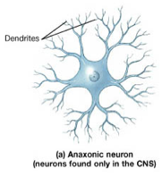
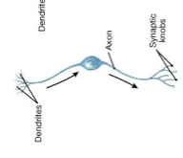
Classification of Neurons - Structure
Structural Classifications:
(1) Anaxonic neuron – have no distinct processes. Located in the brain and special sense organs. Function is poorly understood.
(2) Bipolar neuron – have two distinct processes, one dendrite and one axon with cell body between them. Rare, but found in special sense organs where they relay information about sight, smell, or hearing from receptor cells to neurons.

Slide 20
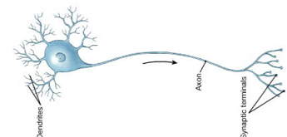
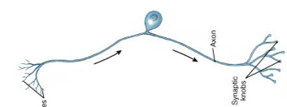
Classification of Neurons - Structure
(3) Unipolar neuron – dendrites and axon are fused together and continuous, cell body lays off to one side. Most sensory neurons of the PNS are unipolar. Very long (a meter or more), longest extend from tips of toes to the spinal cords.
(4) Multipolar neuron – two or more dendrites and one axon. Most common type of neuron in the CNS. Can also be very long.

Slide 21
Classification of Neurons - Functional
Three types of Functional Classification:
(1) Sensory neurons
(2) Motor neurons
(3) Interneurons

Slide 22
Classification of Neurons - Functional
Sensory Neurons – Afferent neurons that make up the afferent component of the PNS; deliver information from sensory receptors to the CNS.
(1) Exteroceptors – provide information about the external environment (touch, temperature, pressure, sight, smell, hearing)
(2) Proprioceptors – monitor the position and movement of skeletal muscles and joints
(3) Interoceptors – Monitor internal environment and provide sensations of taste, deep pressure, and pain

Slide 23
Classification of Neurons - Functional
Motor Neurons – Efferent neurons that make up efferent component of the PNS; carry instructions from the CNS to the peripheral effectors.
(1) Somatic motor neurons – innervate skeletal muscle (conscious control – Somatic Nervous System)
(2) Visceral motor neurons – innervate all peripheral effectors except muscle (Autonomic Nervous System)

Slide 24
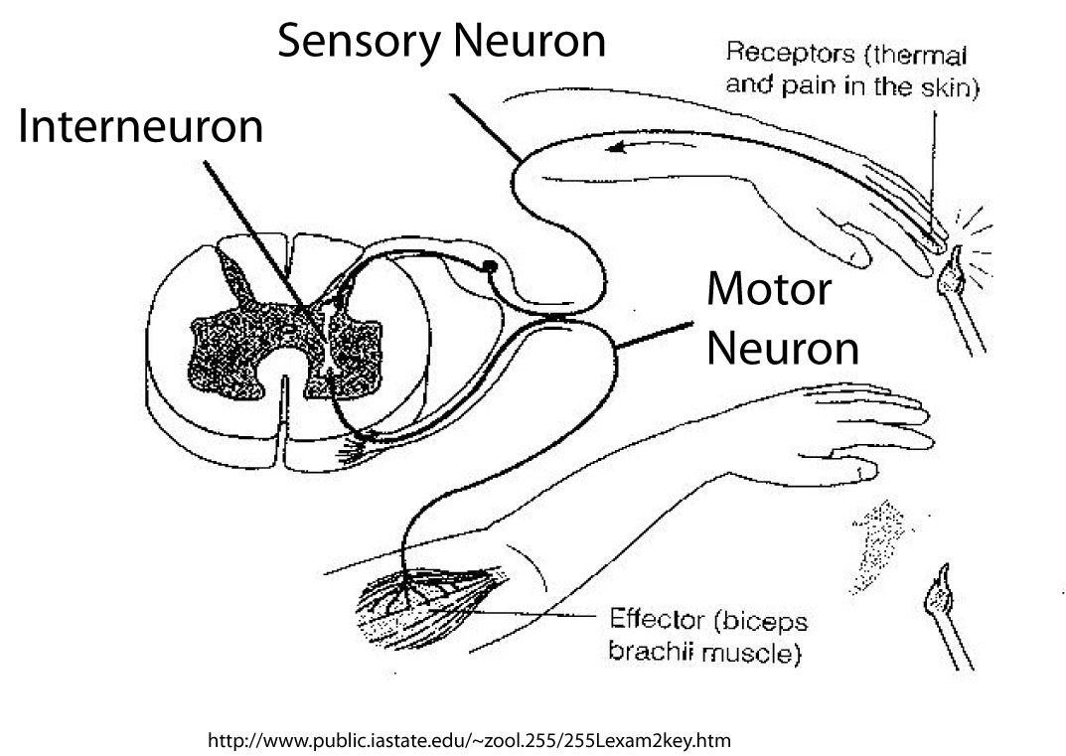
Classification of Neurons - Functional
Interneurons – Most located in brain and spinal cord. Responsible for distribution of sensory information and the coordination of muscle activity. Also involved in higher functions, such as memory, planning, and learning.

