Slide 1
Nervous System - CNS
Brain Anatomy and Function

Slide 2
Brain Facts
Adult human brain contains about 98% of the body’s neural tissue
Average brain weighs about 3 lbs
Brain size varies drastically among males and females (male brain about 10% larger than those of females)
No correlation between brain size and intelligence

Slide 3
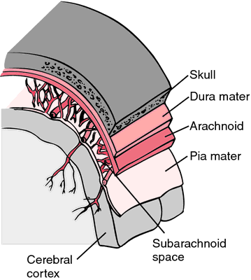
Protection of the CNS
The CNS is protected by:
Bone (skull and vertebral column)
Meninges
Cerebrospinal fluid
Blood-brain barrier

Slide 4
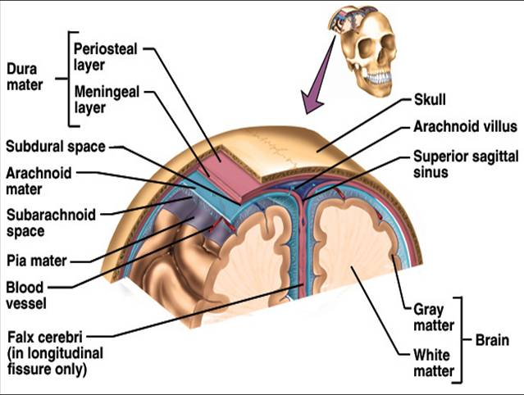
Meninges
Three layers make up the meninges:
1. Dura Mater
2. Arachnoid
3. Pia mater

Slide 5
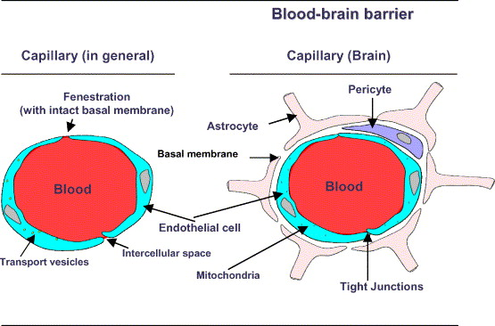
Blood-brain barrier
Allows certain substances to enter the brain, while keeping other substances out
It inhibits many drugs that are not LIPID soluble from reaching brain tissue

Slide 6
Brain anatomy and function
Three major parts of the brain:
1. Cerebrum – largest, sensory and motor functions, higher mental function (memory, reasoning)
2. Cerebellum – coordinate voluntary muscles
3. Brain stem – regulate visceral functions

Slide 7
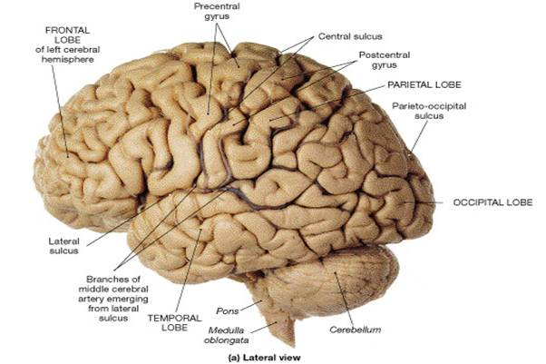
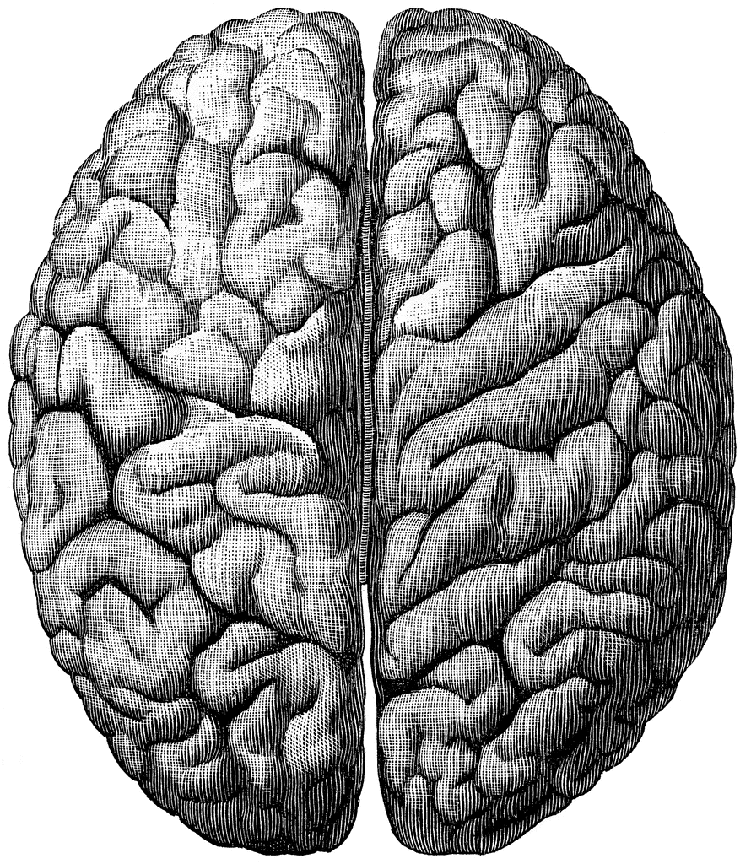
cerebrum
Divided into paired cerebral hemispheres

Slide 8
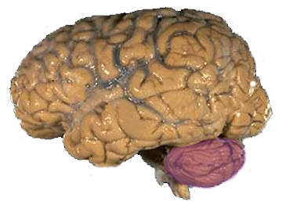
cerebellum
Covered by gray matter, cerebellar cortex
Functions to coordinate voluntary motion

Slide 9
Brain stem
Regulates visceral functions (autonomic system)
Includes:
1. Diencephalon
2. Mesencephalon
3. Pons
4. Medulla oblongata

Slide 10
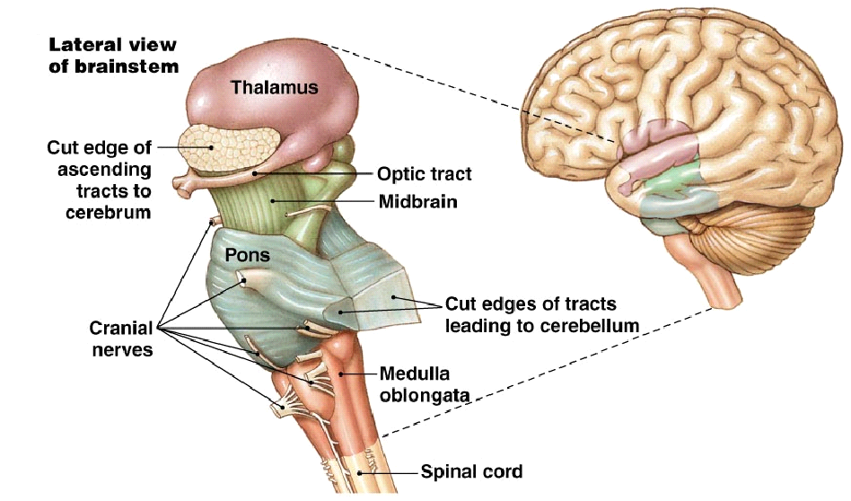
Brain stem

Slide 11
Brain stem - diencephalon
Diencephalon includes the thalamus and hypothalamus glands
Thalamus contains relay and processing centers for sensory information
Hypothalamus is involved with emotions, autonomic function, and hormone production

Slide 12
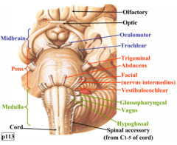
Brain stem – mesencephalon (midbrain)
Mesencephalon is responsible for processing visual and auditory data
Generates somatic reflex responses (EX: response to loud unexpected noises – head turning and eye movement)
Maintenance of consciousness

Slide 13
Brain stem – pons (“the bridge”)
The pons relays sensory information to the cerebellum and thalamus
Also contains nuclei involved with somatic and visceral motor control

Slide 14
Brain stem – medulla oblongata
Spinal cord connects to the brain at the medulla oblongata
Relays sensory information to the thalamus and other parts of the brain stem
Regulates visceral functions = cardiovascular, respiratory, and digestive system

Slide 15
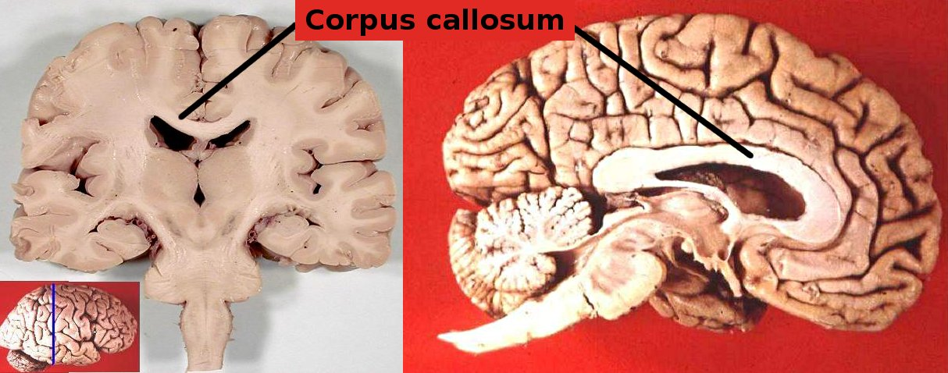
Cerebral hemispheres
Right and left sides of the brain are divided by the corpus callosum that connects the two hemispheres

Slide 16
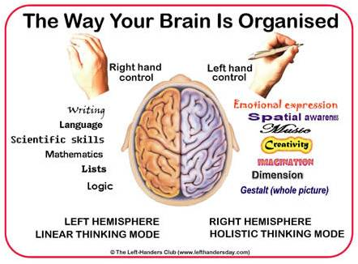
Left brain / right brain test

Slide 17
Convolutions of the brain
The wrinkles and grooves of the cerebrum
Ridges – gyri
Shallow depressions – sulci
Deeper grooves - fissures

Slide 18
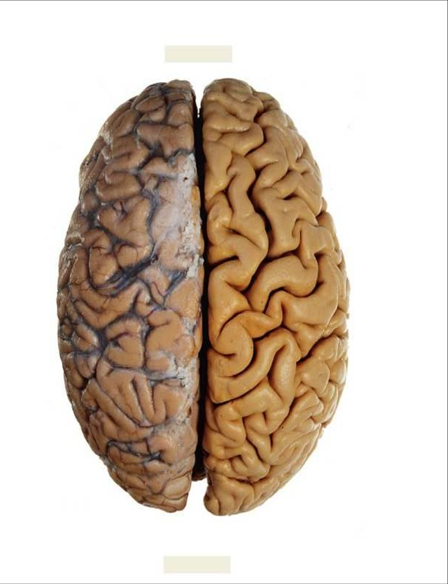
Longitudinal fissure
The longitudinal fissure separates the right lobe of the brain from the left lobe

Slide 19
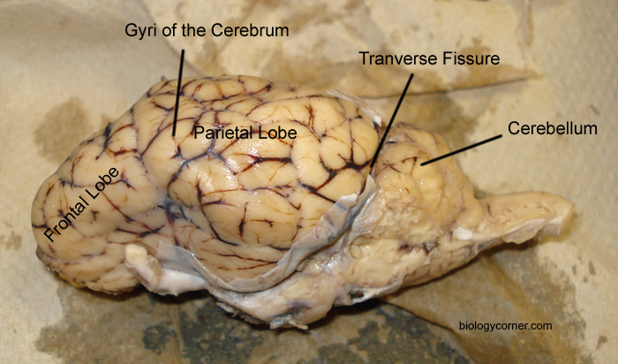
Transverse fissure
Transverse fissure separates cerebellum from the cerebrum

Slide 20
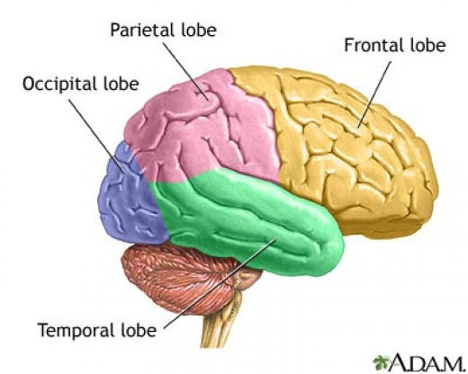
Lobes of the brain

Slide 21
Lobes of the brain - functions
Parietal – touch, pain, relation of body parts
Temporal – hearing
Occipital – vision
Frontal – reasoning, thinking, and language

Slide 22
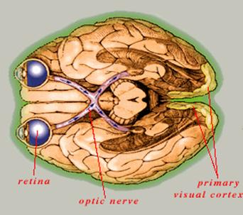
Occipital lobe - vision
Pathway of electric
signals showing how
they move from optic
nerve to visual
cortex

Slide 23
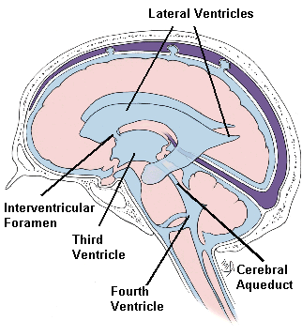
Brain ventricles
Chambers of the brain are called ventricles
Ventricles are lined by ependymal cells that monitor, produce, and circulate CSF

Slide 24
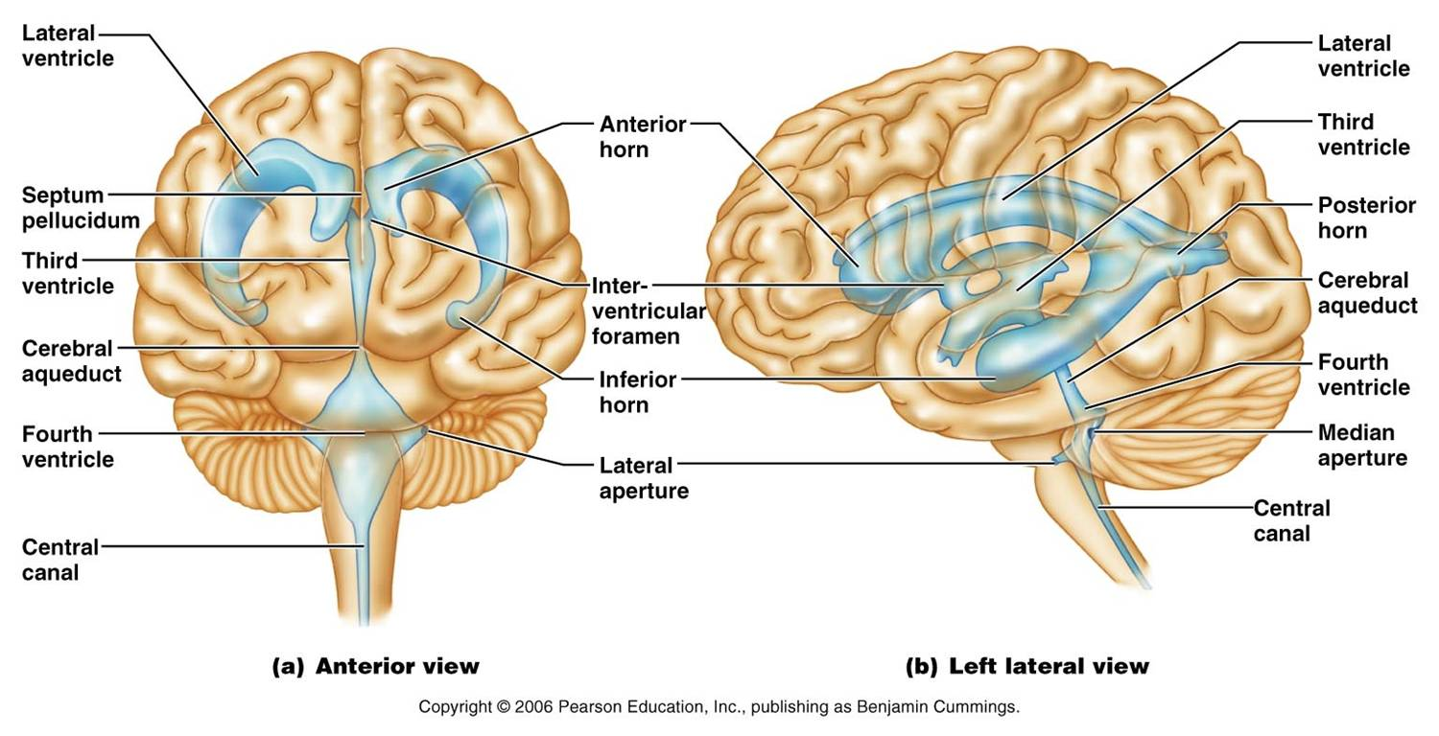
Brain ventricles

Slide 25
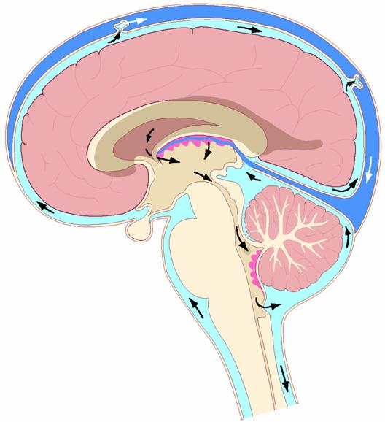
Function of the cerebrospinal fluid
Functions as:
1. Shock absorption
2. Support the weight of the brain
3. Nourishment and waste removal
Whole volume (about 150mL’s ) replaced about every 8 hours
CSF circulation in brain

Slide 26
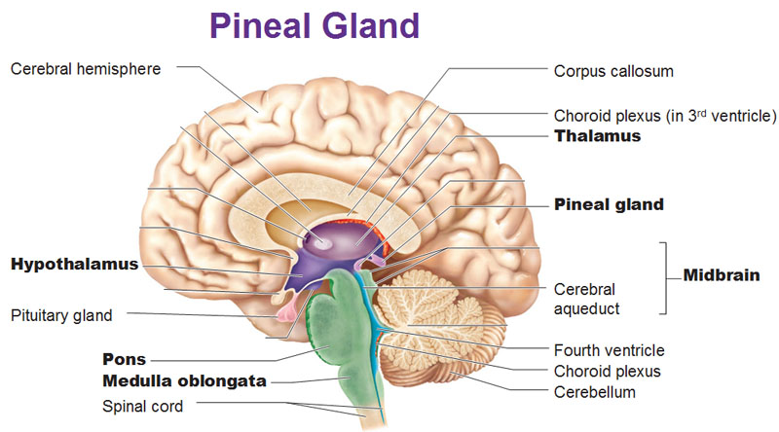
Pituitary gland
The master gland of the endocrine system. It controls hormones.

Slide 27
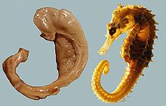
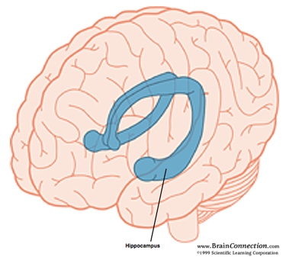
hippocampus
Memory is controlled by the hippocampus.
*Called the hippocampus
because it has a seahorse
shape.

Slide 28
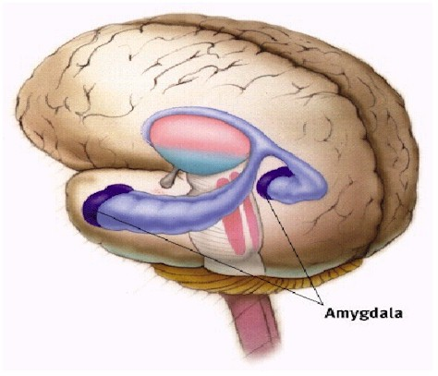
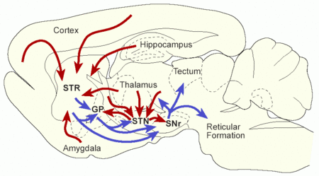
amygadala
Linked to fear responses and pleasure
Size is correlated with aggression
Most sexually-dimorphic organ in humans; upon castration it shrinks by as much as 30%
Conditions such as anxiety, autism, depression, post-traumatic stress disorder, and phobias are suspected of being linked to abnormal functioning of the amygdala

Slide 29
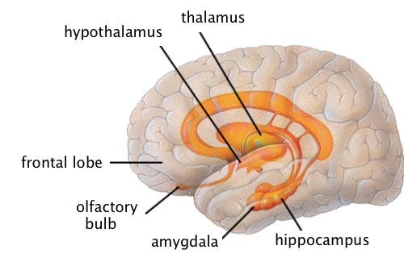
Limbic system
Limbic system plays a role in emotion.
Also includes olfactory lobes – memory, emotion, and smell are linked

Slide 30
Limbic system
Why is the brain formed so that smell and emotions are tied together?
Evolutionary argument: Because pheromones are tied to emotions and behavior, so they need the link

